Slide 1


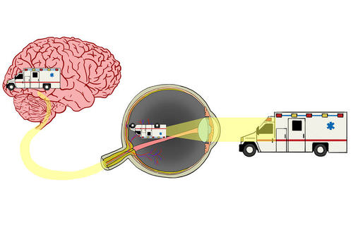
Medical physics-1st year
L16- Physics Of Eyes And Vision
By Assistants professor
Dr.Mohammed Ali Jaber
Physiology Department
College of Medicine
University of Basrah

Slide 2
Learning Objectives
By the end of this section, you will learning about :
Photoreceptors in the Retina
The blind spot of the eye
Some Other Elements Of The Eye
Focusing Images
Focal length, Power of accommodation, and the optical density
How Sharp Are Your Eyes

Slide 3
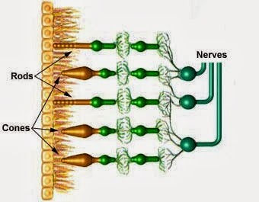
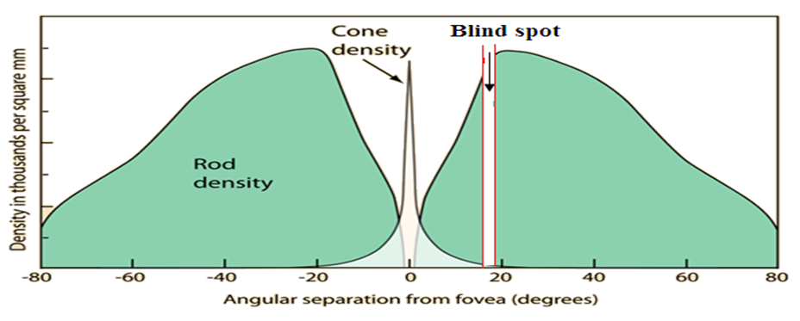
Photoreceptors in the Retina
There are two general types of photoreceptors in the retina: Cones and Rods.
The rods and cones are distributed symmetrically in all directions from visual axis except in one region-blind spot.
Throughout most of the retina the cones and rods are not at the surface of the retina but they lie behind several layers of the nerve tissue through which the light must passes.

Slide 4
The differences between rods and cones in terms of their sensitivity and visual acuity
Rods | Cones
Are spread evenly across the retina but there are none in the fovea. Rod cells are sensitive to low light intensities, so are made the best use of at night. They have a low visual acuity because several rod cells share a connection to the optic nerve. But this also improves the eye's ability to detect small amounts of light. The rods are more numerous, some 120 million. and are the more sensitive than the cones They are not uniformly distributed over the retina but have a maximum density at an angle of about 20° . | There is a higher concentration of cone cells in the fovea. They are more sensitive to high light intensities and therefore color can not be seen very easily when it is dark. Cones have a high visual acuity because each cone cell has a single connection to the optic nerve, so the cones are better able to tell that two stimuli are separate. The cones(~6.5 million in each eye) 5.The cones are not uniformly sensitive to all colors but have a maximum sensitivity at about 550 nm in the yellow – green region.

Slide 5
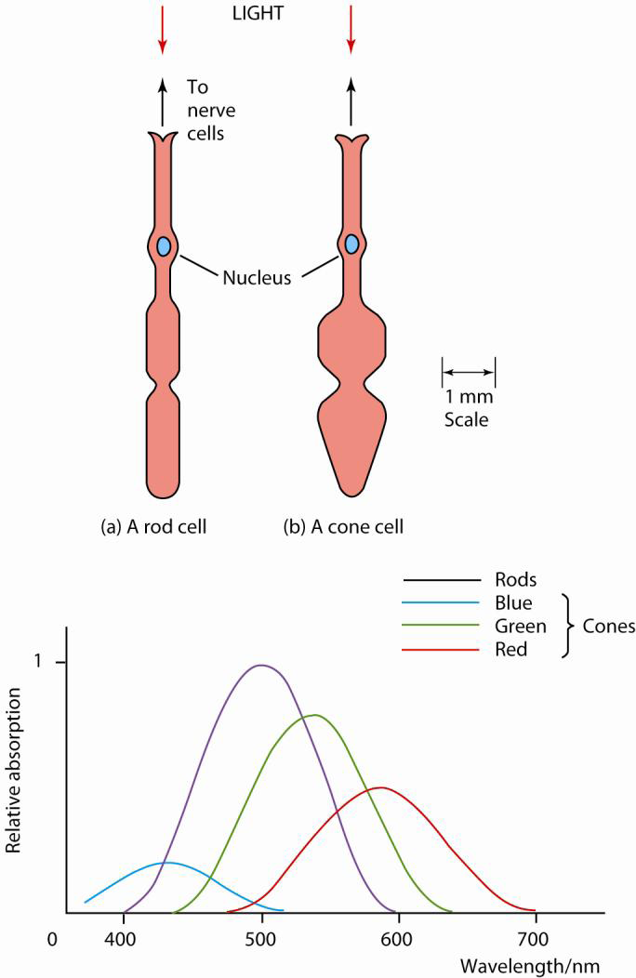
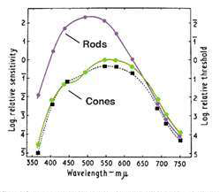
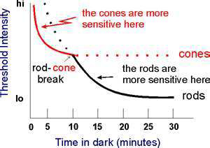
The rods are much more sensitive than the cones. The rods are incredibly efficient photoreceptors

Slide 6
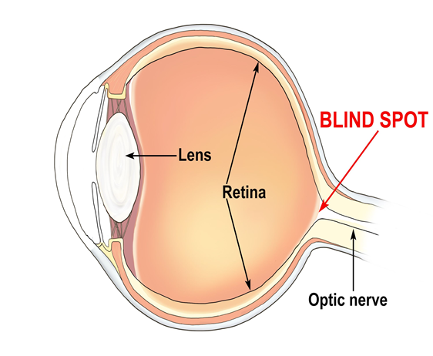
The blind spot of the eye:
Blind spot, small portion of the visual field of each eye that corresponds to the position of the optic disk within the retina.
It is the place in the visual field that corresponds to the lack of light-detecting photoreceptor cells on the optic disc of the retina, where the optic nerve passes through the optic disc.
There are no photoreceptors (i.e., rods or cones) in the optic disk, and, therefore, there is no image detection in this area.

Slide 7
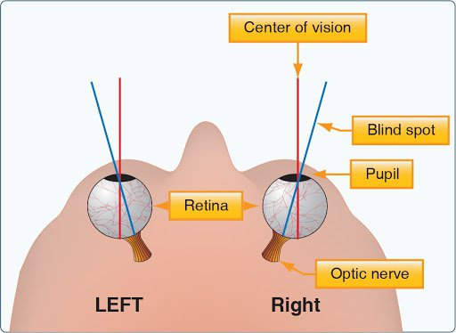
•The blind spot of the right eye is located to the right of the center of vision and vice versa in the left eye. With both eyes open, the blind spots not perceived because the visual fields of the two eyes overlap.

Slide 8
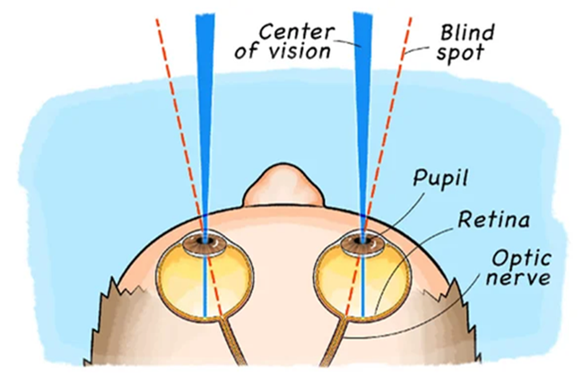
Indeed, even with one eye closed, the blind spot can be difficult to detect subjectively because of the ability of the brain to “fill in” or ignore the missing portion of the image
•As there are no photoreceptor cells in this region, this part of the field of vision is obscured. However, with the help of the input from the surrounding regions of the retina and that of the other eye, the detail of this region can be seen.
•As a result of this, the blind spot is not usually perceived.

Slide 9

All of the nerves of the retina bundle together to form the optic nerve. Where the optic nerve exits the eye there is a blind spot.
At the spot, there are no photoreceptors; therefore no light can be detected.
That has neither rods nor cones. That there is a region from about 13° to 18° (the point, at which the optic nerve enters the eye.)

Slide 10
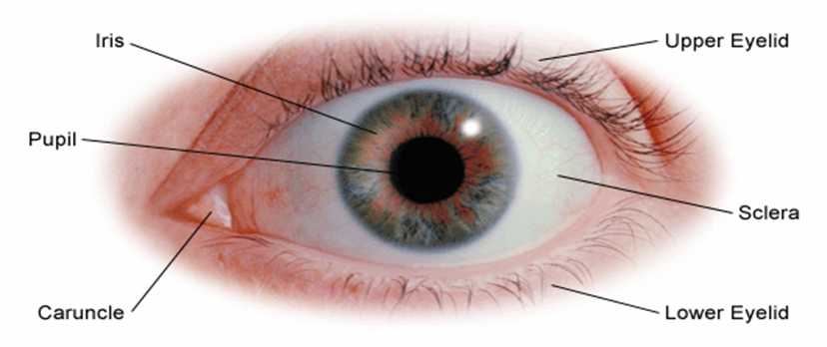
Some Other Elements Of The Eye
-The pupil and iris:
The iris (the colored part of the eye) controls the amount of light entering the eye. It consists of concentric and radial muscle fibers.
The pupil The pupil is the opening at the center of the iris through which light passes.
The range of the eye pupil’s diameter is typically from less than 1 mm up to 10 mm.
The iris adjusts the size of the pupil to control the amount of light that enters the eye.

Slide 11
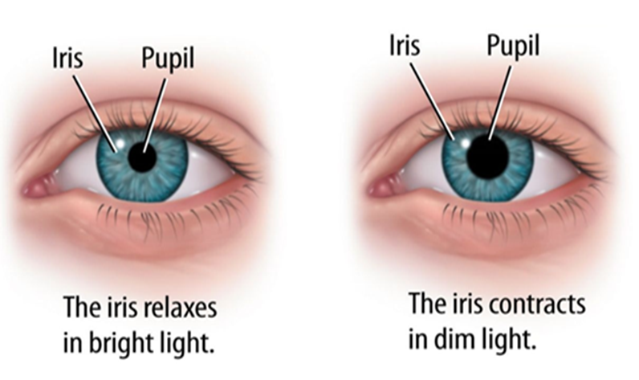
In dim light, the concentric fibers relax and the radial fibers contract so the iris contracts, dilating (i.e. widening) the eye pupil so more light passes into the eye.
In bright light, the concentric fibers contract and the radial fibers relax so the iris expands, making the eye pupil narrower so less light passes through it.

Slide 12
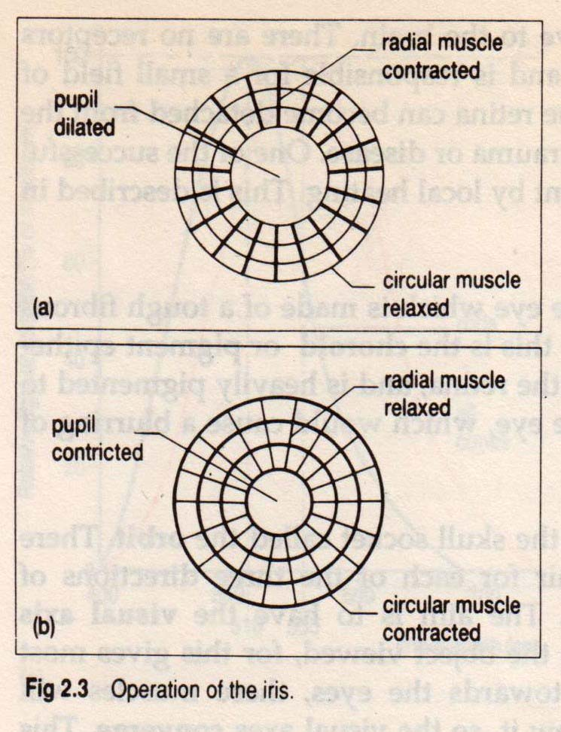
The area of the pupil determines the amount of light entering the eye, which therefore increases, by a factor of 100 when the diameter of the eye pupil increases from 1 mm to 10 mm.

Slide 13
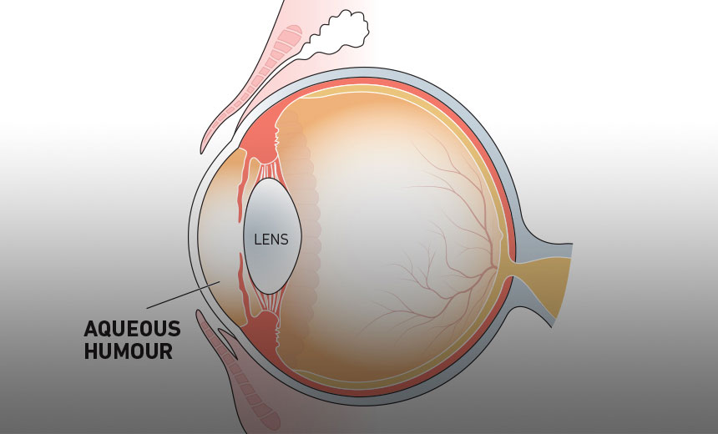
The aqueous humour: is a transparent watery fluid similar to plasma, but containing low protein concentrations.
It is secreted from the Ciliary body, a structure supporting the lens.
It fills both the anterior and the posterior chambers of the eye, and is not to be confused with the vitreous humour,
It is useful for refractive index, prevents eye dryness as well as maintains the eye in a pressurized state.

Slide 14
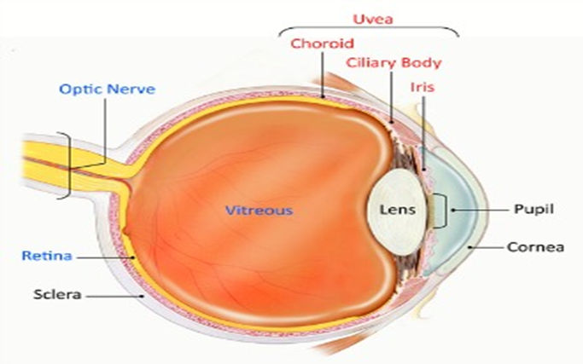
Vitreous humor: is a clear jelly- like substance that fills the large space between the lens and the retina.
It helps the shape of the eye fixed and is essentially permanent. It is sometimes called the vitreous body.
Vitreous humor is comprised primarily of water, and is responsible for giving the eye its form and shape. Because of its viscous properties, the eye returns to its original shape when compressed.

Slide 15
The sclera: Sclera is the external covering of the eye which is made of a tough fibrous tissue to produce the contents. , white, light –tight covering over the entire eye except the cornea. A transparent coating called the conjunctiva protects the sclera.
Eyelid
Shuts automatically to protect the eye from possible danger and Tears help your eyes by: Washing away germs, keeping them from drying out and Keeping dust or other particles out.

Slide 16
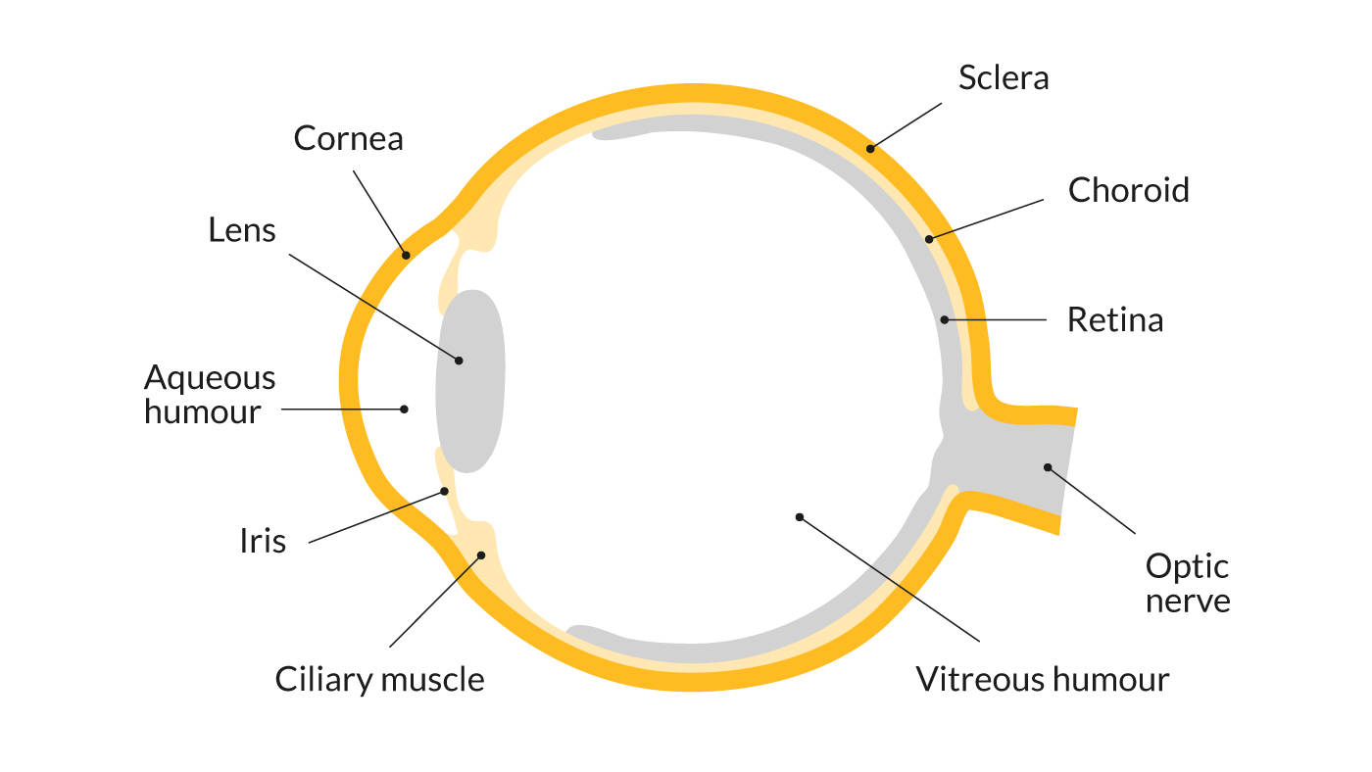

Slide 17
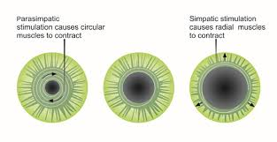
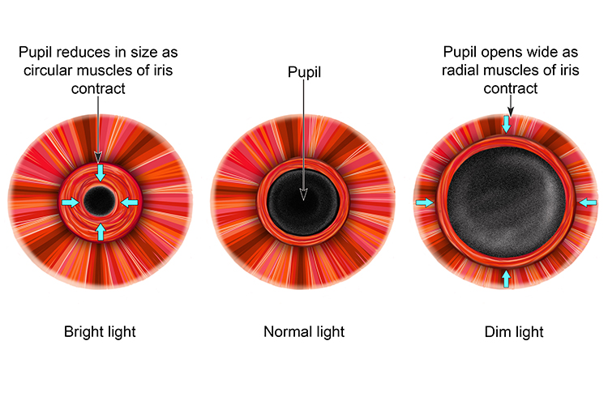
Focusing Images
1. Focusing by the iris
The iris controls the amount of light that enters the eye by contraction and relaxation of the radial and circular muscles in the iris. This increases the size of the pupil so more light enters when it is dark and the reverse in bright conditions.

Slide 18
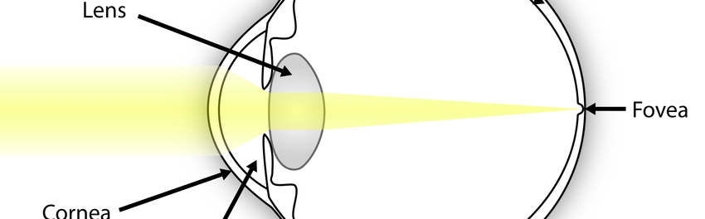
2. Focusing by accommodation (refraction)
Every part of the eye refracts (or bends) light by different amounts.
Most refraction occurs in the cornea because it is curved. However, this always bends it by the same amount, therefore we adjust the shape of the lens to vary the refractive index to focus light on the retina.
About 80% of the refraction occurs in the cornea
About 20% of the refraction occurs in the inner crystalline lens

Slide 19
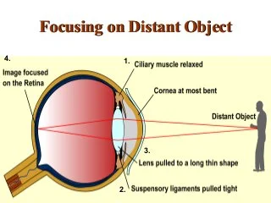
The eye's responses to focusing on different objects changes depending on the distance to the object:
•Distant objects require less refraction. The ciliary muscles relax, this causes the suspensory ligaments to be pulled tense. This stretches the lens and makes it longer and thinner or less convex.

Slide 20
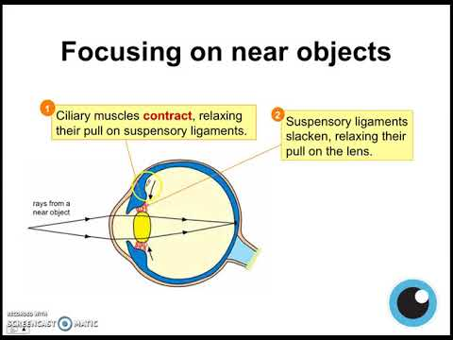
Near Objects require more refraction. The ciliary muscles contract, causing the suspensory ligaments to slacken. This makes the lens become shorter and fatter and more refraction occurs.
After the light from the object you want to look at passes through the lens, it will be focused on the retina.

Slide 21
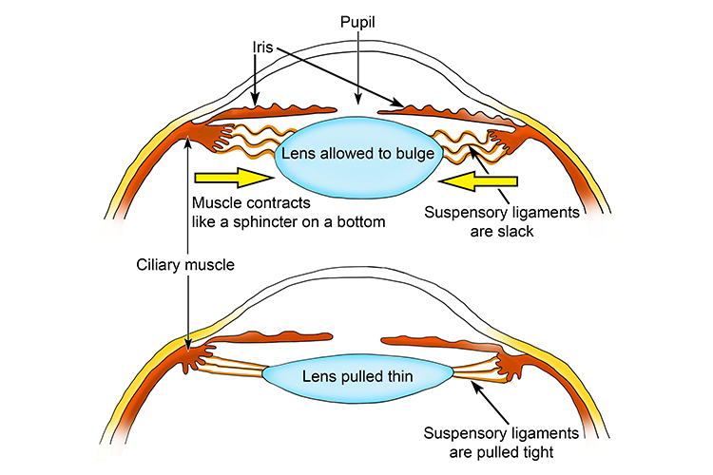
Suspensory ligament of lens:
a series of fibers that connect the ciliary body of the eye with the lens, holding it in place.
Near Objects require more refraction.
Distant objects require less refraction.

Slide 22
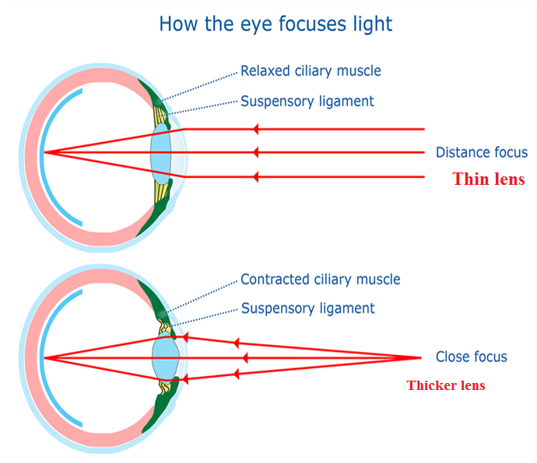

Slide 23
Thank you

